Slide 1
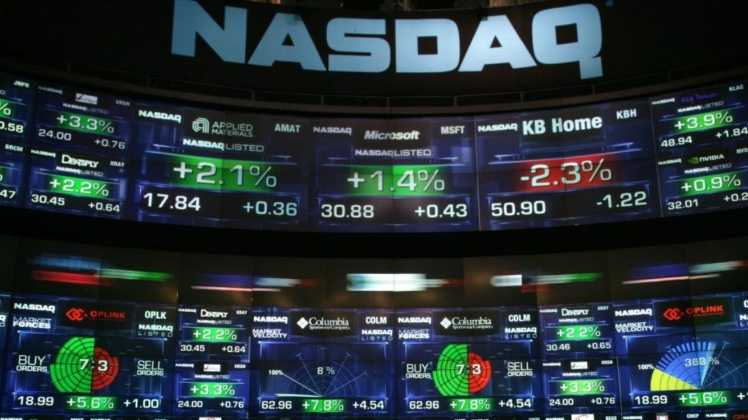
Which Industry is best to invest in 2018?
Telecom vs Oil Stocks
Group: Cassio, Juan, Kendall

Slide 2
Overview
Problem statement
Context
The Analyses
Oil or Telecom.
Which industry is a better stock investment in 2018?
Which company best performed by industry?
Top three companies from both industries
$1,500 as base investment
Latest data available: 2017
Source data: (API) data.nasdaq.com
Two sectors were analyzed using the same four metrics
Quarterly Percentage Change in Stock Prices
Quarterly Stock Trading Volume
Quarterly Volatility (Standard Deviation of Daily Returns)
Cumulative ROI

Slide 3
Date Conversion: The 'Date' column was converted to datetime format.
Sorting: The data was sorted by 'Company' and 'Date'.
Handling Missing Values: Forward fill and backward fill methods were applied to handle missing values.
Nasdaq Data API
Was generated One chart per calculation per industry
Data Source
Exploration
Cleanup Process
Calculation
Plotting
The percentage change in adjusted close prices for each quarter
The total stock volume for each quarter was summed to understand trading activity.
The standard deviation of daily returns within each quarter was calculated to measure volatility.
The cumulative ROI was added to a new column to measure the total return on investment of $1,500 over 2017
Daily stock prices and trading volumes for AT&T, T-Mobile, Verizon, Chevron, Conoco, Exxon Mobile

Slide 4

Analysis visual

Slide 5
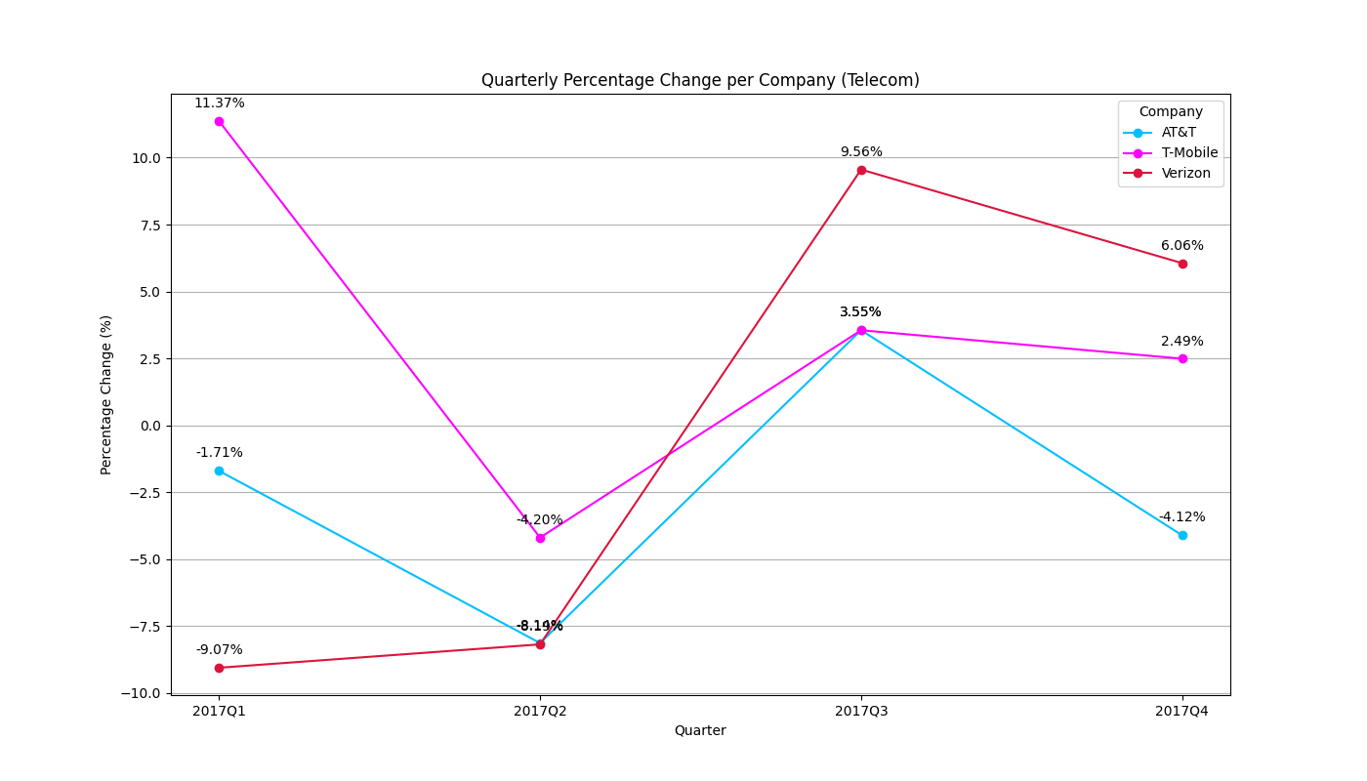
Telecom Stock Change Findings
Overview: Telecom sector saw a mixed performance, with AT&T being the only company to finish the year with a loss, down 4% from its initial buy price.
Notes:
Talking point:
Q1: T-Mobile and Verizon had contrasting performance, with T-Mobile 10% above and Verizon 10% below their initial buy prices.
Q2: All companies experienced losses, with T-Mobile suffering the most, down 15% from Q1.
Q3: Verizon rebounded significantly, rising 16% from previous Q
Q4: Verizon achieved the highest return, closing the year 6% above its initial buy price.
Overview: Telecom sector saw a mixed performance, with AT&T being the only company to finish the year with a loss, down 4% from its initial buy price.

Slide 6
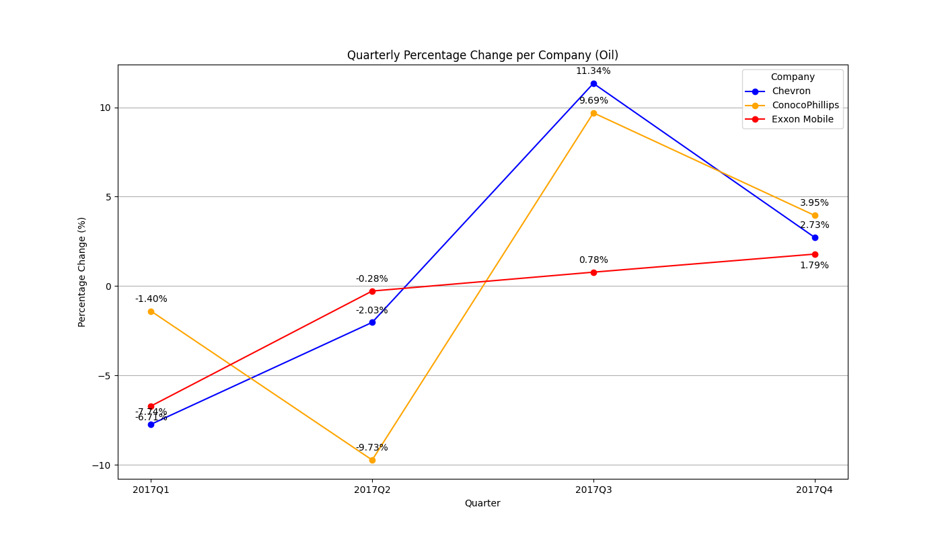
Oil Stock Change Findings
Overview: After initial losses, all three companies saw a strong recovery by year-end. ConocoPhillips rebounded nearly 20% from Q2, Exxon rose over 11%, and all three ended within 5% of their initial buy prices.
Notes:
Talking point:
Q1 saw a loss across all 3 companies observed.
Q2 ConocoPhillips continued to decline while Exxon and Chevron got to within 2% of the initial buy price.
Q3 had the greatest percentage increases with ConocoPhillips climbing almost 20% from Q2 and Exxon also increasing to just over 11% of initial buy price.
By end of year all 3 oil companies finished within 5% of their initial buy price.

Slide 7
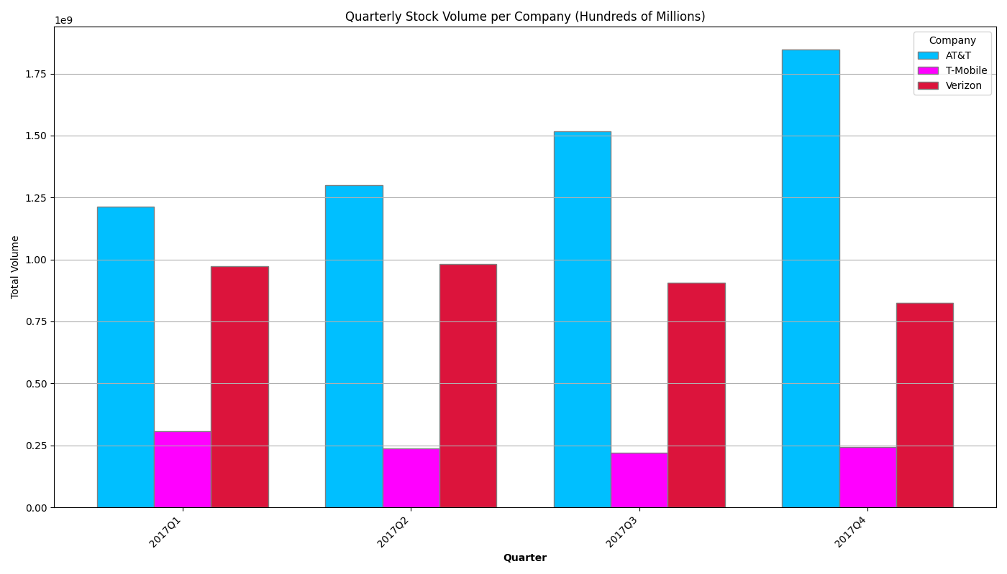
Telecom Stock Volume Findings
Overview: AT&T's trading volume steadily increased each quarter, indicating rising investor interest. T-Mobile saw a decline from Q1 to Q3 with a slight recovery in Q4, suggesting a minor rebound due to year-end events. Verizon's trading volume fluctuated, with a slight increase in Q2 followed by a consistent decline in Q3 and Q4, reflecting decreasing investor interest or negative sentiment.
Notes:
Talking point:
AT&T: Trading volume shows a consistent increase each quarter. The steady rise in volume suggests increasing investor interest or significant market events positively influencing trading activity.
T-Mobile: trading volume exhibits a decline from Q1 to Q3, with a slight recovery in Q4. The slight increase in Q4 suggests a minor recovery, possibly due to market events or strategic announcements towards the year-end.
Verizon: Shows a fluctuating pattern with a slight increase in Q2 followed by a consistent decline in Q3 and Q4. The steady decline from Q3 to Q4 suggests decreasing investor interest or negative market sentiment impacting trading volumes.

Slide 8
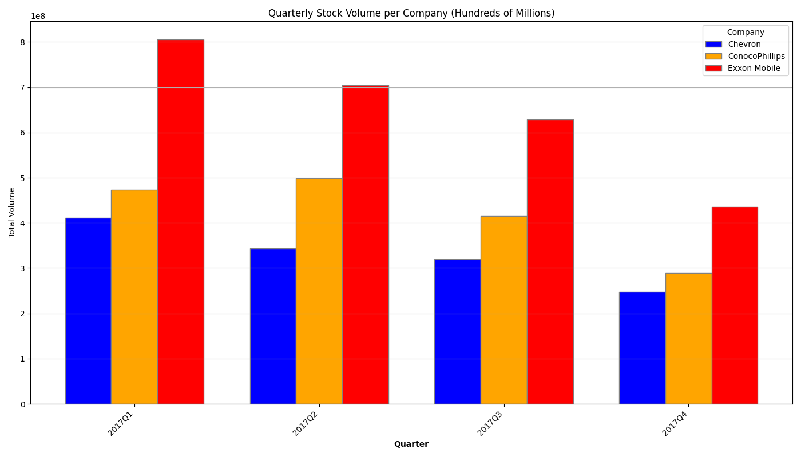
Oil Stock Volume Findings
Overview: Chevron experienced a consistent decline in trading volume each quarter, indicating reduced investor interest. Conoco saw an initial increase in volume from Q1 to Q2, but then faced sharp declines, especially between Q2 and Q4. Exxon began with the highest trading volume but faced steady decreases throughout the year, though it maintained higher volumes compared to Chevron and ConocoPhillips.
Notes:
Talking point:
Chevron: Trading volume shows a consistent decline each quarter indicating a reduction in trading activity or investor interest throughout the year.
Conoco: Experiences a volume increase from Q1 to Q2 and then the volume declines sharply, especially between Q2 and Q3, and even more so from Q3 to Q4. The substantial decrease in Q4 suggests a significant drop in trading activity towards the end of the year.
Exxon: Starts with the highest volume among the three companies in Q1 but then consistenly decrese through the year. Despite the declines, Exxon Mobile maintains a higher trading volume throughout the year compared to Chevron and ConocoPhillips.

Slide 9
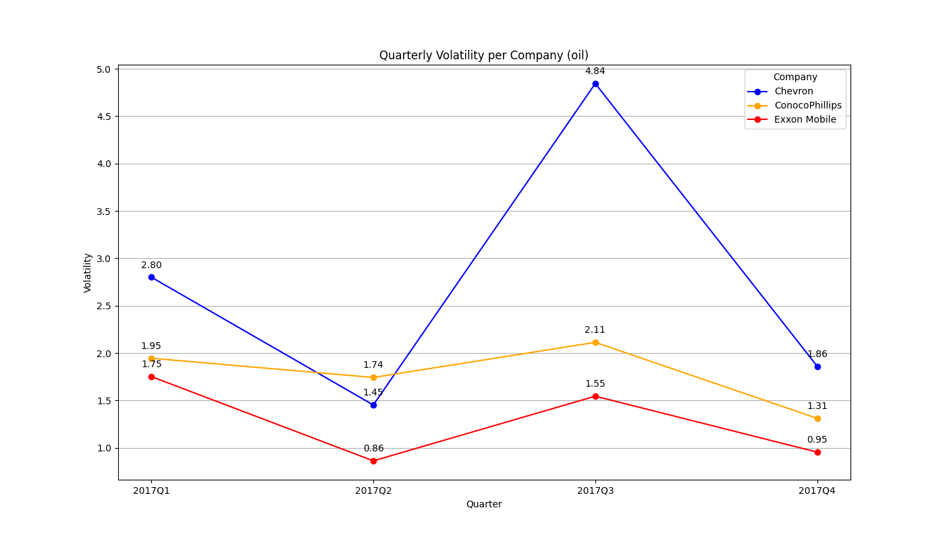
Oil Volatility Findings
Overview: Chevron's trading showed high volatility and volume in Q1, stabilizing with reduced activity by Q4. Conoco experienced high volume and moderate volatility in Q1, but saw decreasing volatility and volume by Q4. Exxon had high trading volume and moderate volatility throughout the year, with stability and reduced activity by Q4.
Notes:
Talking point:
Chevron: High volatility and substantial trading volume in Q1 suggest significant market activity and investor reactions to early-year financial reports. Throught the year fluctuated multiple times but the continued decrease in both volatility and volume in Q4 reflects further market stabilization and reduced investor activity.
Conoco: In Q1, moderate volatility with high trading volume indicates significant market interest and steady price fluctuations. Q2 sees a slight decrease in volatility with peak volume, suggesting a stable price environment despite high trading activity. In Q3, increased volatility alongside decreased volume reflects higher price fluctuations, by Q4, the lowest volatility and volume indicate reduced market activity and price stability, with less investor interest towards the year-end.
Exxon: Moderate volatility with the highest trading volume suggests a balanced environment of significant market activity and steady price movements. Q2 sees the lowest volatility and decreased volume, indicating market stability and reduced investor activity, reflecting strong investor confidence and fewer price fluctuations. By Q4, low volatility and further decreased volume indicate a stable market with minimal price fluctuations and lower investor activity towards the year-end.
Chevron's trading showed high volatility and volume in Q1, stabilizing with reduced activity by Q4. Conoco experienced high volume and moderate volatility in Q1, but saw decreasing volatility and volume by Q4. Exxon had high trading volume and moderate volatility throughout the year, with stability and reduced activity by Q4.

Slide 10
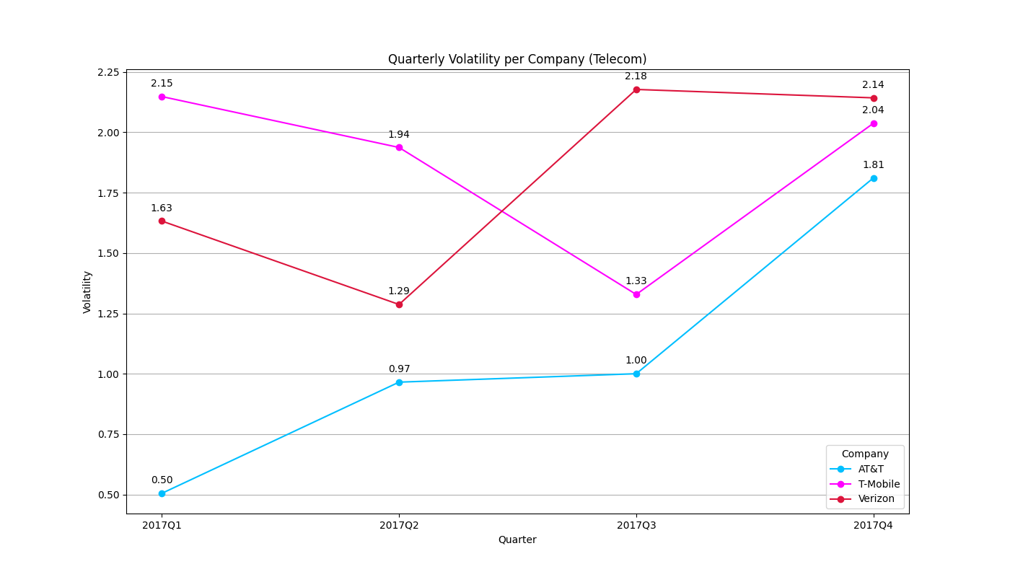
Telecom Volatility Findings
Overview: AT&T saw a steady increase in trading volume and volatility throughout the year, peaking in Q4, indicating growing investor interest. T-Mobile had high volatility in Q1, decreasing towards Q3, then rising again in Q4, reflecting fluctuating investor interest. Verizon experienced high volatility and volume initially, with a peak in Q3 and high volatility but low volume by year-end, suggesting significant price fluctuations but reduced investor interest.
Notes:
Talking point:
AT&T: shows a steady increase in both trading volume and volatility throughout the year, peaking in Q4. This indicates growing investor interest and significant price fluctuations towards the year-end, reflecting strong market activity and potential reactions to corporate or market events.
T-Mobile: Exhibits high volatility in Q1, which decreases towards Q3 before increasing again in Q4. Trading volume follows a similar pattern, indicating varying investor interest and price stability throughout the year, with significant fluctuations and renewed interest in Q4.
Verizon: Starts the year with high volatility and substantial volume, which decreases in Q2, followed by a peak in volatility in Q3 despite reduced volume. The year ends with high volatility but the lowest volume, suggesting significant price fluctuations but waning investor interest.

Slide 11
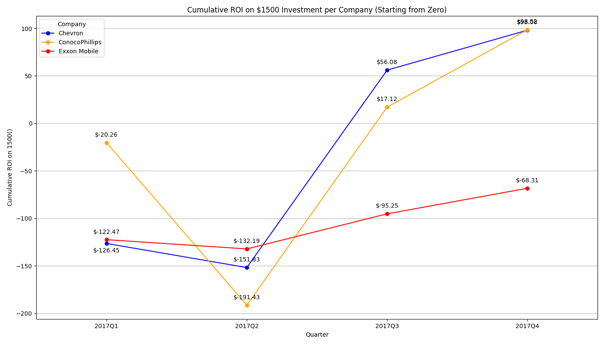
Oil Return of Investment Findings
Chevron performed the best in the energy sector
ConocoPhillips also showed significant recovery after a challenging first half, finishing the year with a positive cumulative ROI
Notes:
Talking point:
ROI, or Return on Investment, is a financial metric used to evaluate the profitability or efficiency of an investment. It measures the return relative to the cost of the investment.
Chevron performed the best in the energy sector, ending the year with a cumulative ROI of $56.08. Despite early losses, Chevron recovered strongly in the latter half of the year.
ConocoPhillips also showed significant recovery after a challenging first half, finishing the year with a positive cumulative ROI of $17.12. Though the gains were modest, it outperformed Exxon Mobile that has a consistent Losses or -$95.25, making the company the weakest performer in the energy sector.

Slide 12
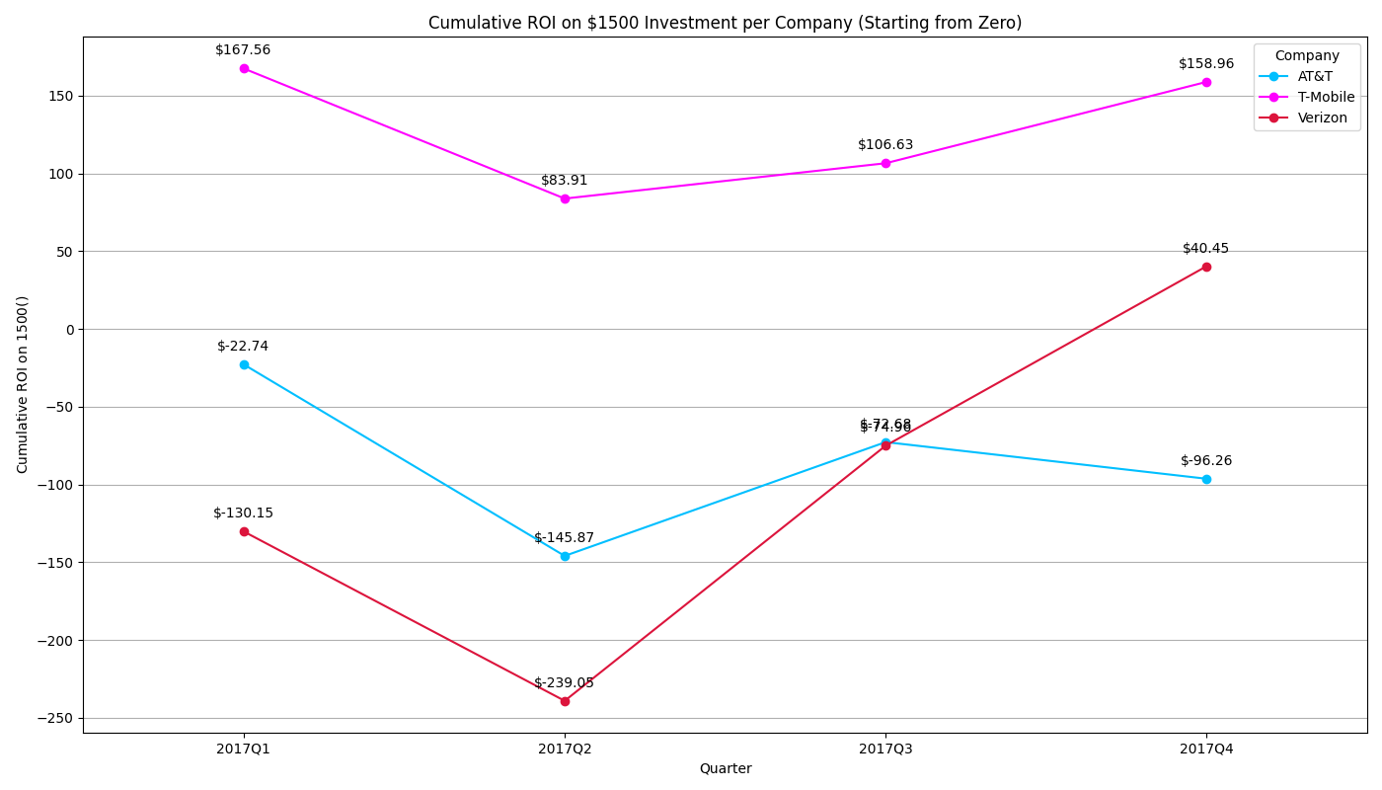
Telecom Return of Investment Findings
T-Mobile was winner, ending 2017 with a positive cumulative ROI of $106.63.
Both AT&T and Verizon faced challenges throughout the year, finishing with negative cumulative
Notes:
Talking point:
T-Mobile was the clear winner, ending 2017 with a positive cumulative ROI of $106.63. Despite some quarterly fluctuations, it consistently generated gains, making it the best investment in the telecom sector.
Both AT&T and Verizon faced challenges throughout the year, finishing with negative cumulative ROIs of -$72.68 and -$74.96, respectively. Although Verizon showed some recovery in the later quarters, neither company managed to produce a positive ROI by year-end.

Slide 13
Conclusion
Both sectors showed varying degrees of volatility, with T-Mobile and Chevron managing to turn around early losses, while companies like AT&T, Verizon, and Exxon Mobile struggled to recover fully.
T-Mobile and Chevron were the top performers in their respective sectors, providing the most favorable returns for investors in 2017.

Slide 14

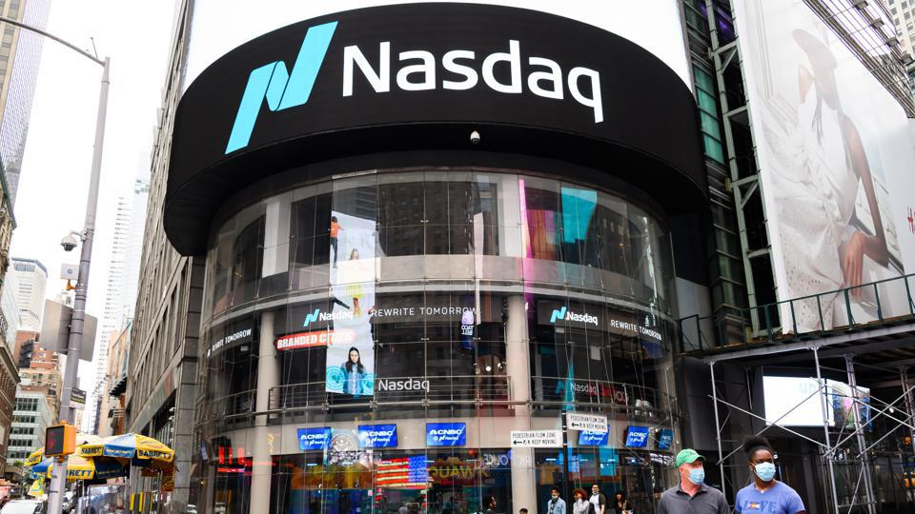
Thank you!

Slide 15
Project Requirements
Nasdaq was chosen due to the data availability and API connection, which provided enough data for analyses.
The industry was chosen based on the team's interest.
Just enough data to allow a simple analysis and conclusion.

